Slide 1
String Matching Algorithms

Slide 2
String Matching Problem
Let Σ denotes the set of alphabets.
Given:
A string of alphabets T[1..n] of size n and
a pattern P[1..m] of size m
where m << n
To Find:
Whether the pattern P occurs in text T or not
If it does, then give all occurrences of P in T
Pattern P occurs with shift s in T if P[1...m] = T[s+1...s+m]
Motivations: text-editing, pattern matching in DNA sequences

Slide 3
Naive String Matching Algorithm
T :
P :
a b c a b d a a b c d e
a b d

Slide 4
Naive String Matching Algorithm
T :
P :
a b
c a b d a a b c d e
a b
d
Mismatch after 3 Comparisons

Slide 5
Naive String Matching Algorithm
T :
P :
a b c a b d a a b c d e
a b d
Mismatch after 1 Comparison

Slide 6
Naive String Matching Algorithm
T :
P :
a b c a b d a a b c d e
a b d
Mismatch after 1 Comparison

Slide 7
Naive String Matching Algorithm
T :
P :
a b c
a b d
a a b c d e
a b d
Match found after 3 Comparisons
Thus, after 8 comparisons the substring P is found in T.

Slide 8
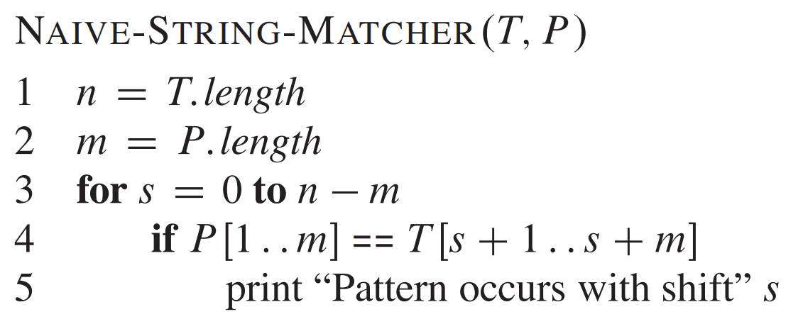
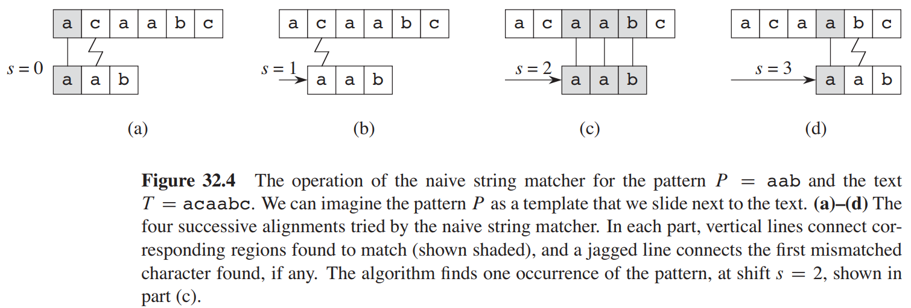
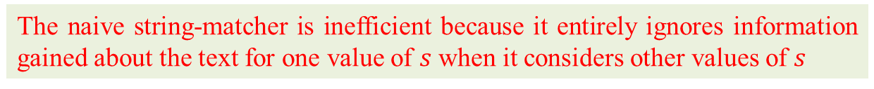
Naive String Matching Algorithm
worst-case running time is Θ((n-m+1)m)
The naive string-matcher is inefficient because it entirely ignores information gained about the text for one value of $s$ when it considers other values of $s$
How to do better?
32.4

Slide 9
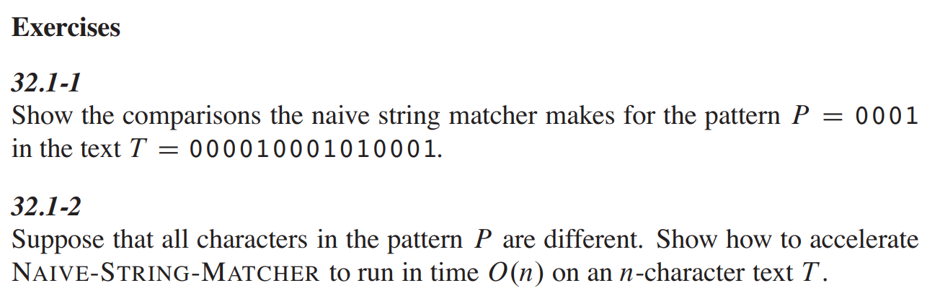

Slide 10

Rabin-Karp Algorithm
The Rabin-Karp algorithm uses $O\left(m\right)$ preprocessing time, and its worst-case running time is $Θ\left(\left(n−m+1\right)m\right)$. Based on certain assumptions, however, its average-case running time is better.

Slide 11
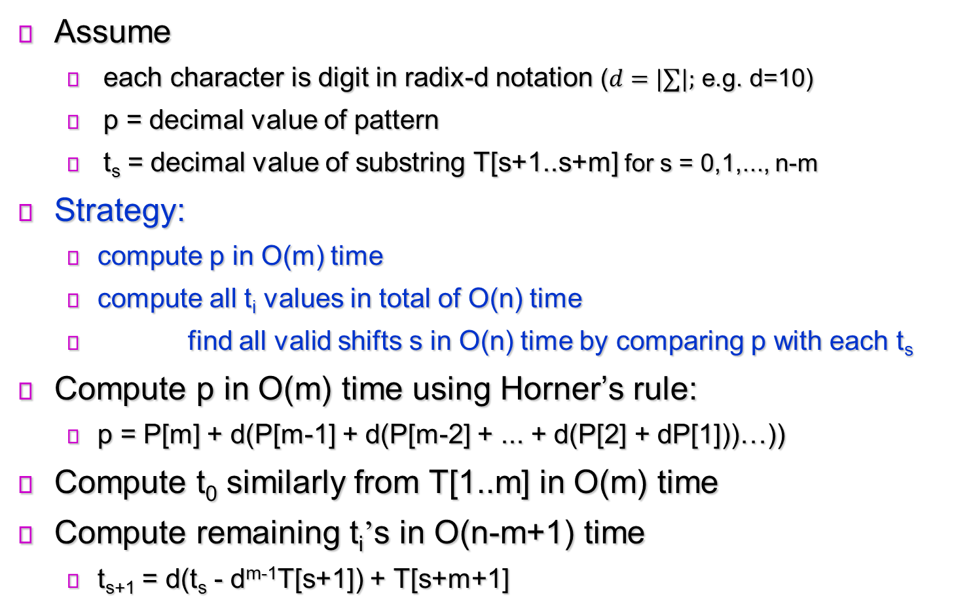
Rabin-Karp Algorithm
Assume
each character is digit in radix-d notation ($d=|∑|;$ e.g. d=10)
p = decimal value of pattern
t_{s} = decimal value of substring T[s+1..s+m] for s = 0,1,..., n-m
Strategy:
compute p in O(m) time
compute all t_{i} values in total of O(n) time
find all valid shifts s in O(n) time by comparing p with each t_{s}
Compute p in O(m) time using Horner’s rule:
p = P[m] + d(P[m-1] + d(P[m-2] + ... + d(P[2] + dP[1]))…))
Compute t₀ similarly from T[1..m] in O(m) time
Compute remaining t_{i}’s in O(n-m+1) time
t_{s+1} = d(t_{s} - d^{m-1}T[s+1]) + T[s+m+1]

Slide 12
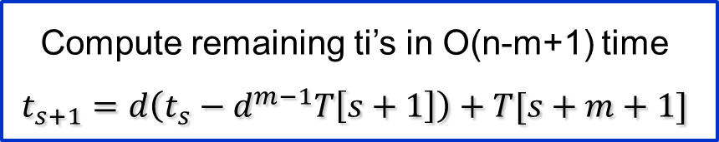
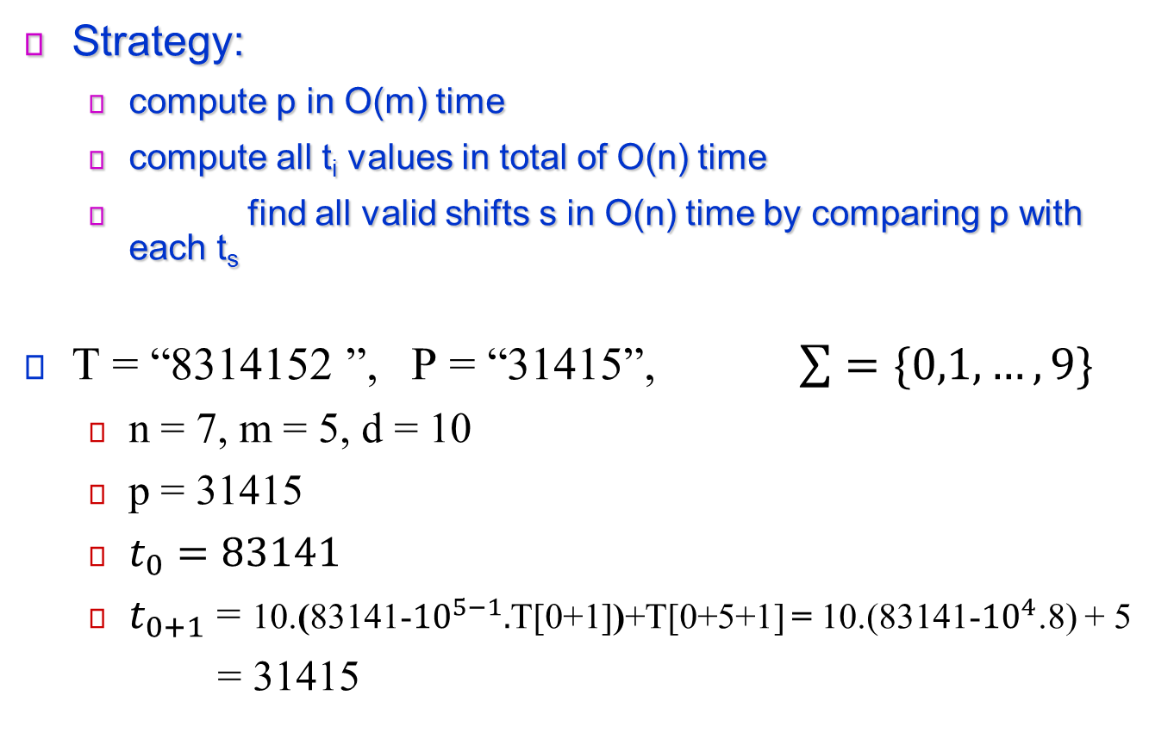
Rabin-Karp Algorithm
Strategy:
compute p in O(m) time
compute all t_{i} values in total of O(n) time
find all valid shifts s in O(n) time by comparing p with each t_{s}
T = “8314152 ”, P = “31415”, $\sum{=\{0,1,…,9\}}$
n = 7, m = 5, d = 10
p = 31415
$t_{0}=83141$
$t_{0+1}$ = 10.(83141-${10}^{5−1}.$T[0+1])+T[0+5+1] = 10.(83141-${10}^{4}$.8) + 5
= 31415
Compute remaining ti’s in O(n-m+1) time
$$t_{s+1}=d\left(t_{s}−d^{m−1}T\left[s+1\right]\right)+T[s+m+1]$$

Slide 13
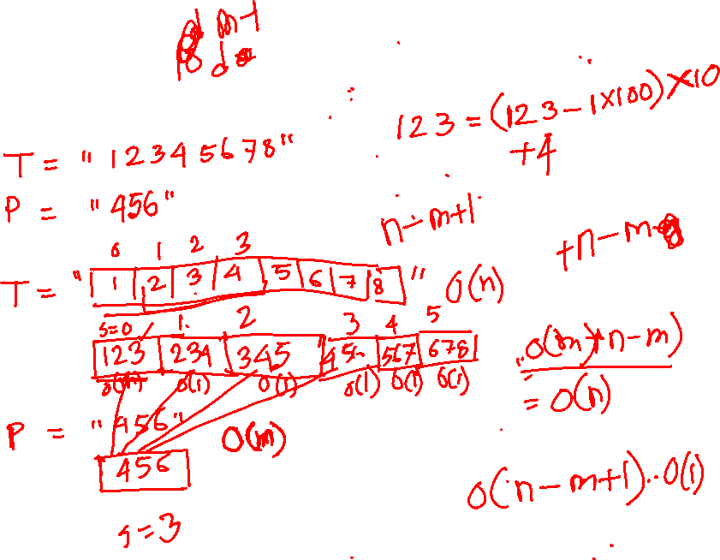

Slide 14
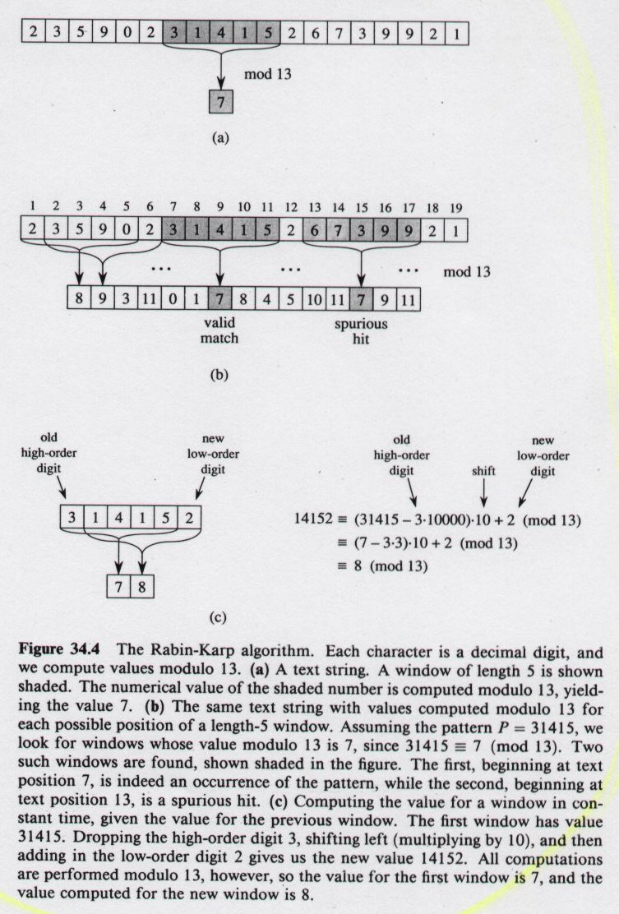
Rabin-Karp Algorithm
$p$ and $t_{s}$ may be too large to work with conveniently. If $P$ contains $m$ characters, then we cannot reasonably assume that each arithmetic operation on $p$ (which is $m$ digits long) takes “constant time.”
But...
p, t_{s} may be large, so use mod
32.5

Slide 15
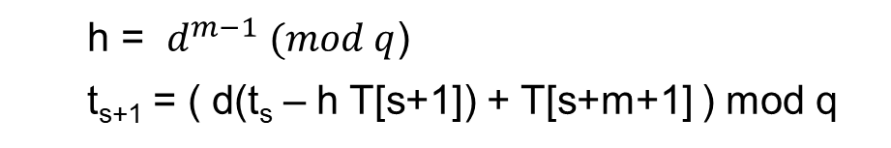
Rabin-Karp Algorithm
h = $d^{m−1} (mod q$)
t_{s+1} = ( d(t_{s} – h T[s+1]) + T[s+m+1] ) mod q
p = 31415
spurious
hit

Slide 16
Rabin-Karp Algorithm

Slide 17
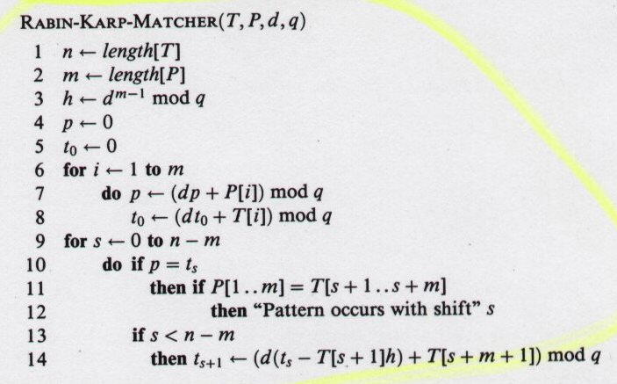
Rabin-Karp Algorithm
d is radix q is modulus
Θ(m)
high-order digit position for m-digit window
Preprocessing
Θ(m)
Matching loop invariant: when line 10 executed
t_{s}=T[s+1..s+m] mod q
Θ((n-m+1)m)
rule out spurious hit
Θ(m)
worst-case running time is in Θ((n-m+1)m)

Slide 18
Naive algorithm, runtime,
#substring of length m in a string of length n?
What is the problem with naïve?
Rabin karp ideal scenario
What happened if we do not mod in RKA
How to fix that
Runtime analysis?
Why modulo? worst case scenario?
What is spurious hit?
When the worst case scene of RKA will happen?
Working with modulo q = 13 and d = 10, find all valid matches and spurious hits (incorrect matches) in the text T = “41591851" for pattern P = “159", using the Rabin-Karp algorithm.

Slide 19
Working with modulo q = 13 and d = 10, find all valid matches and spurious hits (incorrect matches) in the text T = “41591851" for pattern P = “159", using the Rabin-Karp algorithm.

Slide 20
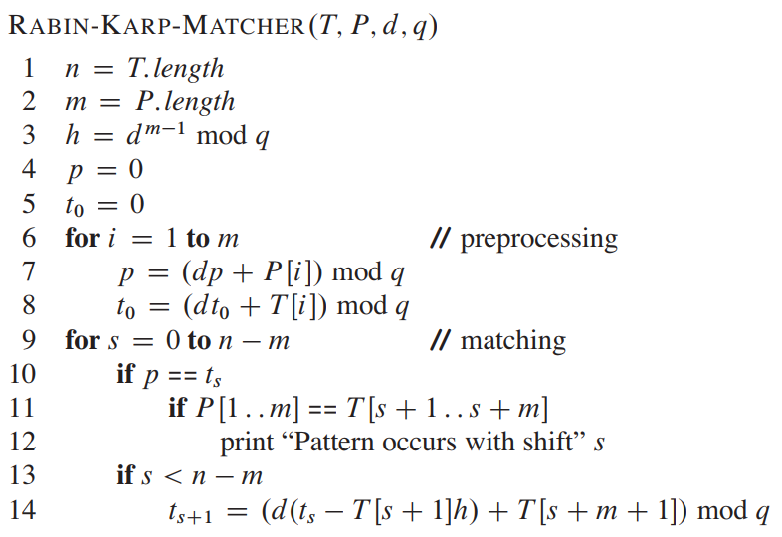
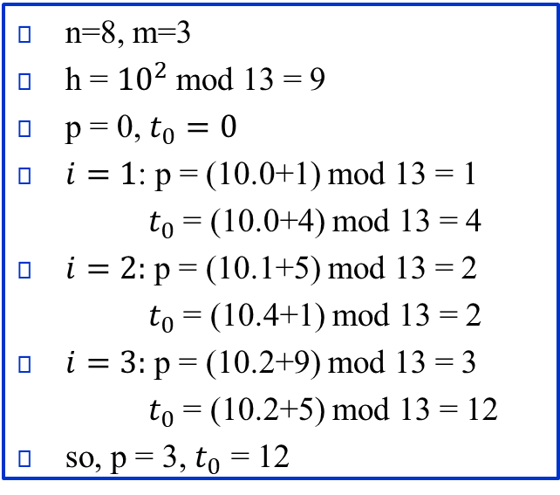
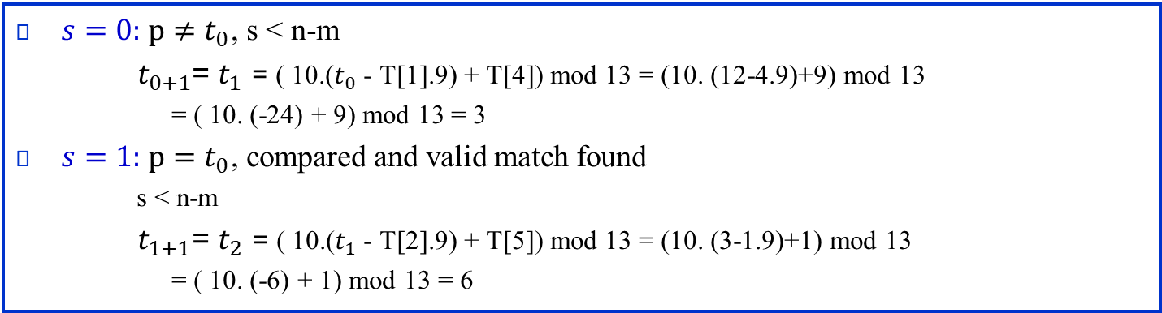
Working with modulo q = 13 and d = 10, find all valid matches and spurious hits (incorrect matches) in the text T = “41591851" for pattern P = “159", using the Rabin-Karp algorithm.
n=8, m=3
h = ${10}^{2}$ mod 13 = 9
p = 0, $t_{0}=0$
$i=1$: p = (10.0+1) mod 13 = 1
$t_{0}$ = (10.0+4) mod 13 = 4
$i=2:$ p = (10.1+5) mod 13 = 2
$t_{0}$ = (10.4+1) mod 13 = 2
$i=3:$ p = (10.2+9) mod 13 = 3
$t_{0}$ = (10.2+5) mod 13 = 12
so, p = 3, $t_{0}$ = 12
$s=0:$ $p≠t_{0}$, s < n-m
$t_{0+1}$= $t_{1}$ = ( 10.($t_{0}$ - T[1].9) + T[4]) mod 13 = (10. (12-4.9)+9) mod 13
= ( 10. (-24) + 9) mod 13 = 3
$s=1:$ $p=t_{0}$, compared and valid match found
s < n-m
$t_{1+1}$= $t_{2}$ = ( 10.($t_{1}$ - T[2].9) + T[5]) mod 13 = (10. (3-1.9)+1) mod 13
= ( 10. (-6) + 1) mod 13 = 6

